Slide 1
IARC Maze solving bot

Slide 2
COMPONENTS OF THE BOT
ARDUINO UNO
6 LED IR SENSOR ARRAY
CASTOR WHEEL
MOTOR
MOTOR DRIVER

Slide 3
OBJECTIVE OF THE BOT
The objective of the bot is to solve a maze and then return to its starting point in the least possible time.

Slide 4
HOW DOES THE BOT WORK
The basic functioning of the robot can be described in the following way:-
The IR sensor array detects the line and sends required information to the arduino which then in turn instructs the motor driver to move accordingly.

Slide 5
ROLE OF EACH COMPONENT
ARDUINO UNO - These systems provide sets of digital and analog I/O pins that can be interfaced to various expansion boards (so-called shields) and other circuits.It get its information from the IR sensor array and hence directs the motor driver to function accordingly.

Slide 6
IR SENSOR ARRAY- This array consists of a series of emitting and receiving LEDs. The emitter diodes emit IR rays which are received by the receiving ones. The intensity of the received signals leads to the different outputs.This helps the robot to find its path through the maze.

Slide 7
PID
A proportional-integral-derivative controller (PID controller) is a control loop mechanism (controller) widely used in industrial control systems. A PID controller calculates an error value as the difference between a measured process variable and a desired setpoint. The controller attempts to minimize the error by adjusting the process through use of a manipulated variable.

Slide 8
PROBLEMS FACED WHILE MAKING THE BOT
CONFUSION IN DECIDING THE DESIGN.
SELECTING A MOTOR WITH SUFFICIENT TORQUE
RPM OF THE TWO MOTORS NOT BEING THE SAME.
PROBLEM IN DECIDING THE COMBINATION OF DELAYS AND LEAP TIMES.
PROBLEM IN WRITING THE CODE FOR PID

Slide 9
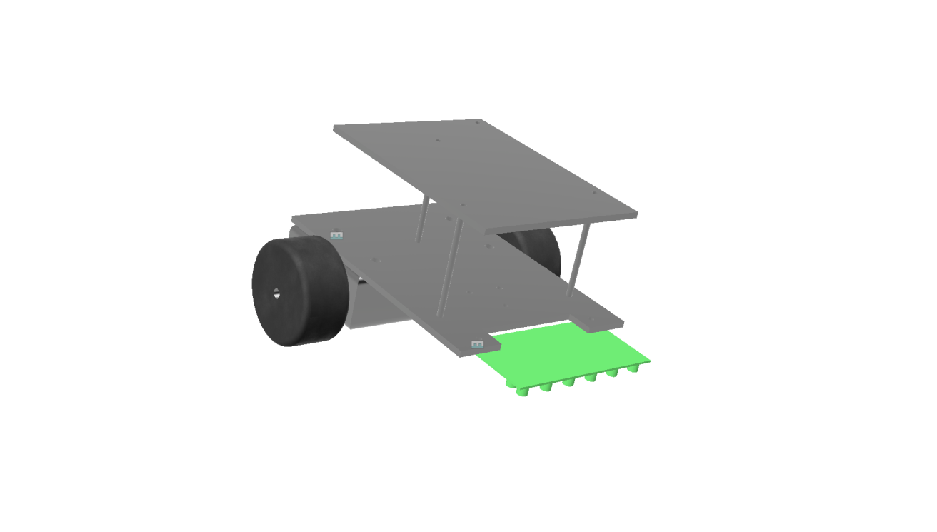
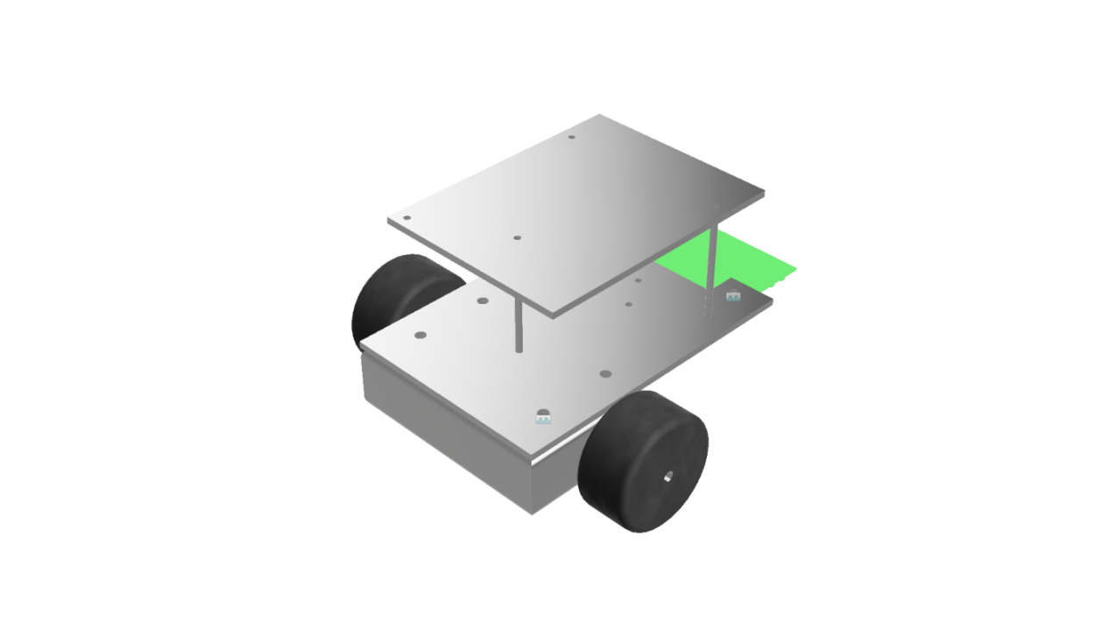
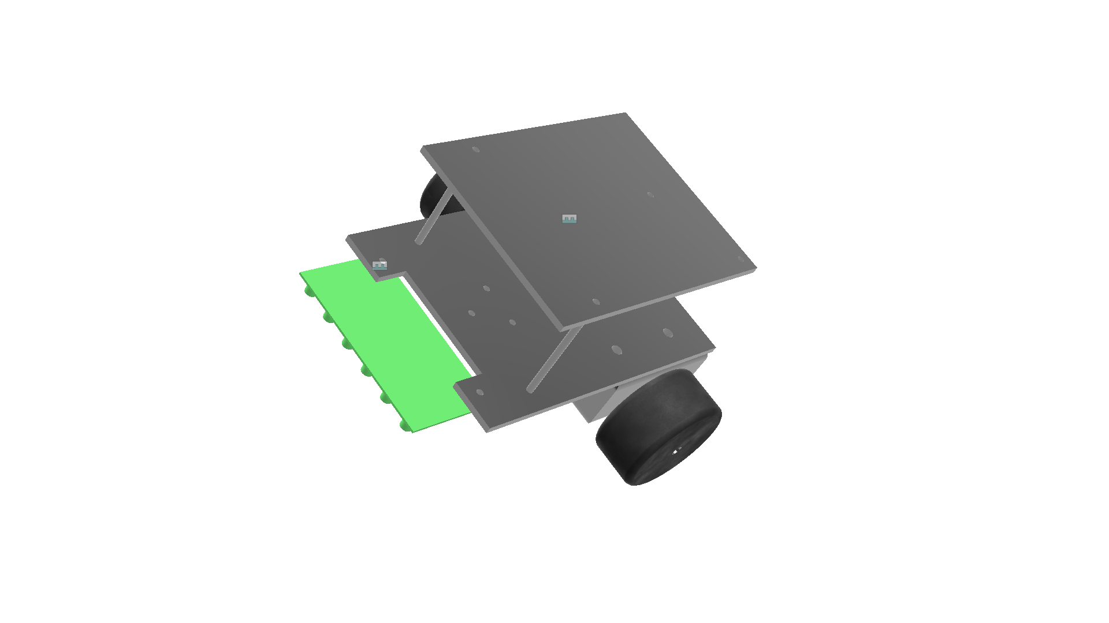
DESIGN OF THE BOT

Slide 10
THINGS TO BE DONE
WRITING A MORE EFFICIENT CODE FOR PID.
WALL FOLLOWING.

Slide 11
TEAM MEMBERS
AKSHAY SHARMA
AKASH SINGH
RISHABH YADAV
AAYUSH DVIWEDI
ALOK KUMAR

